Slide 1

Architectural Home Plan Design Supporting System with Knowledge Base Inspection
Interim Progress III
R.P.M.C.Rajapaksha
ICT/08/09/018
2298

Slide 2
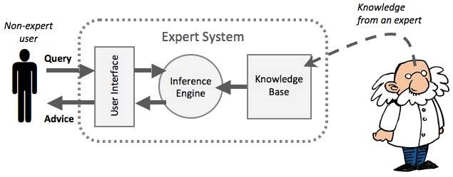
Knowledge Base Implementation
Geometrical Rules
Architectural Rules
Legal Rules

Slide 3
Summary of Implemented Geometrical Rules
Define a Line
Define a Polygon
Just a set of polygons does not represent a house
Define interconnection of two polygons
Interconnected polygons should not be overlapped

Slide 4
Knowledge Base Implementation Current Stage
Geometrical Rule Terminology
Geometrical Rules

Slide 5
Geometrical Rule Terminology Addressed
Geometrical Rule Terminology
There should be a path to move from any polygon to any other polygon
A polygon should satisfy a minimum, maximum area and a minimum width
Windows should be placed properly

Slide 6
1. There should be a path to move from any polygon to any other (cont)
Geometrical Rule Terminology
There should be at least one open path in the boundary of the house. Eg: as the main door
There should be more than one step in the path between two private areas and the middle step should be through a public area
In a special case such as attached bathroom, bathroom should be reached only through the particular attached area

Slide 7
1. There should be a path to move from any polygon to any other (cont)
Geometrical Rule Terminology
bedroom
2
bath
3
bed
room
living
1

Slide 8
2. A polygon should satisfy a minimum, maximum area
Geometrical Rule Terminology
Why
To check whether a polygon satisfies the minimum and maximum area required by a specific type of a polygon
Eg : minimum area required by a bedroom : 11 square meters

Slide 9
Find the Area of a Polygon
Geometrical Rule Terminology
y
y2
Y = (y1 + y2) / 2
y1
X = (x2 – x1)
Area
area 1 = X * Y
Area = area 1 + area 2 + area 3 + area 4 + area 5
area 1
x
x1
x2

Slide 10
2. A polygon should satisfy a minimum width
Geometrical Rule Terminology
Why
To check whether a polygon satisfies the minimum width required by a specific type of a polygon
Eg : minimum width required by a bedroom : 3 meters

Slide 11
Find the Width of a Polygon
Geometrical Rule Terminology
Get the points which have maximum distance from each other
Get the lines perpendicular to above line
Get the maximum length line as the width of the polygon

Slide 12
3. Windows should be placed properly
Geometrical Rule Terminology
Windows should be placed in the boundary of the house
Or
On a line of a polygon which contains open boundary lines of the house
Or
On a polygon which does not have a roof

Slide 13
3. Windows should be placed properly (cont)
Geometrical Rule Terminology
3
Courtyard
1
Kitchen
2
Open Verandah

Slide 14
Knowledge Base Implementation Current Stage
Architectural Rule Terminology
Architectural Rules Basic Terminology
1. Find the Direction of a Polygon with respect to the centroid of the house

Slide 15
1. Find the Direction of a Polygon with respect to the centroid of the house
Architectural Rule Terminology
Why
To find the
Rooms position
Main door position
Windows position
Find the center is allowable for regular polygons
But for irregular polygons we need to calculate the centroid of the polygon

Slide 16
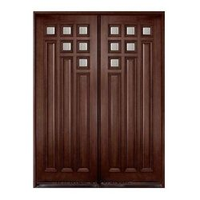

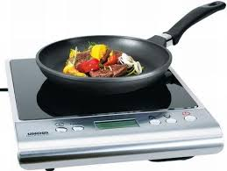
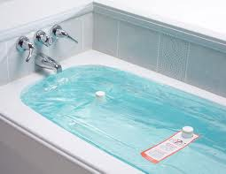




Architectural Terminologies
Architectural Rule Terminology
Ventilation
Main Door
North
Kitchen
Wash Room
West
East
Main Door
Study Room
South
Bed Room
Kitchen

Slide 17
1. Find the Direction of a Polygon (cont)
Architectural Rule Terminology
Find the centroid of the house
Find the centroid of the polygon
Assume North Direction
Calculate the tangent value
According to the tangent value determine the direction of the polygon

Slide 18
Take the list of polygons of the house
Architectural Rule Terminology
1. Find the Direction of a Polygon (cont)

Slide 19
Architectural Rule Terminology
1. Find the Direction of a Polygon (cont)
Remove the inner lines of the polygon
Take the list of lines of the polygons and delete the common lines and get the boundary of the polygon
Then order the list of lines and calculate the centroid
Prolog Code

Slide 20
Remove the inner lines of the polygon
Architectural Rule Terminology
1. Find the Direction of a Polygon (cont)

Slide 21
Find the centroid of the house
Architectural Rule Terminology
1. Find the Direction of a Polygon (cont)

Slide 22
Find the centroid of the specific polygon
Architectural Rule Terminology
1. Find the Direction of a Polygon (cont)

Slide 23
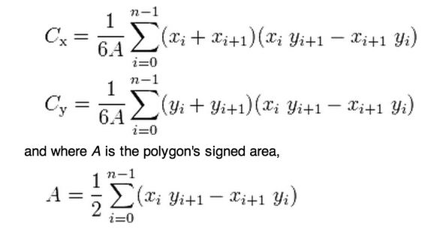
Find the centroid of a polygon - Equation
Architectural Rule Terminology
1. Find the Direction of a Polygon (cont)

Slide 24
Architectural Rule Terminology
1. Find the Direction of a Polygon (cont)
θ

Slide 25
Architectural Rule Terminology
1. Find the Direction of a Polygon (cont)
Tan θ | θ > 180 | θ°
0 | 0 | 0
0.01745506 | no | 1
0.03492077 | no | 2
…. | no | ….
1 | no | 45
∞ | no | 90
-1 | no | 135
0 | 180 | 180
1 | yes | 225
∞ | yes | 270
-1 | yes | 315
0 | 360 | 360

Slide 26
Architectural Rule Terminology
1. Find the Direction of a Polygon (cont)
θ° | Direction
22.5 – 67.5 | North East
67.5 – 112.5 | East
112.5 – 157.5 | South East
157.5 – 202.5 | South
202.5 – 247.5 | South West
247.5 – 292.5 | West
292.5 – 337.5 | North West
337.5 – 360 or 0 – 22.5 | North
270 | West
315 | North West
360 | North

Slide 27
Knowledge Base Implementation Current Stage
Legal Rule Terminology
Legal Rules Basic Terminology
1. Find the distances from the edges

Slide 28
Legal Rules
Legal Rule Terminology
Septic tank
Edge of land to edge of house >10’
Wall to roof edge > 2.5’
Blind wall
Distance
should
be > 50’
Edge of land to window wall> 7.5’
Window
Bedroom – min 100 sqft
Bathroom – min 35 sqft
Living room – min 250 sqft
Dining room – min 120 sqft
Blind wall ->
No windows,
doors
well
Road
Center of road to edge of house > 12’

Slide 29
1. Find the distances from the edges
Legal Rule Terminology
The boundary of the land should be represented by a polygon
The house should be inside the above polygon
The house can have walls in the margin of the land polygon and it is called as blind wall

Slide 30
Next…
Implement above mentioned terminologies in prolog.
Identify the other architectural and legal terminologies

Slide 31
Thank You

